Slide 1
Wyjaśnialna sztuczna inteligencja
Weronika Hryniewska

Slide 2
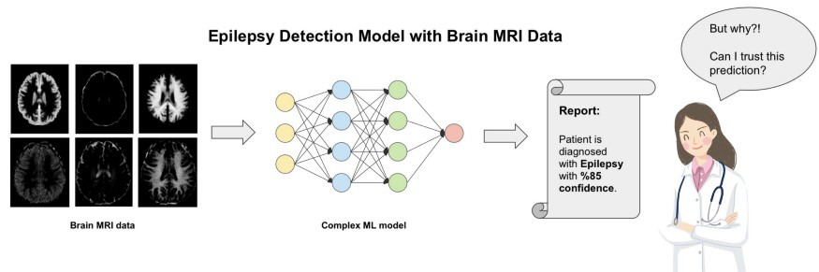
https://medium.com/altaml/how-explainable-artificial-intelligence-xai-can-help-us-trust-ai-8f01b574102d

Slide 3
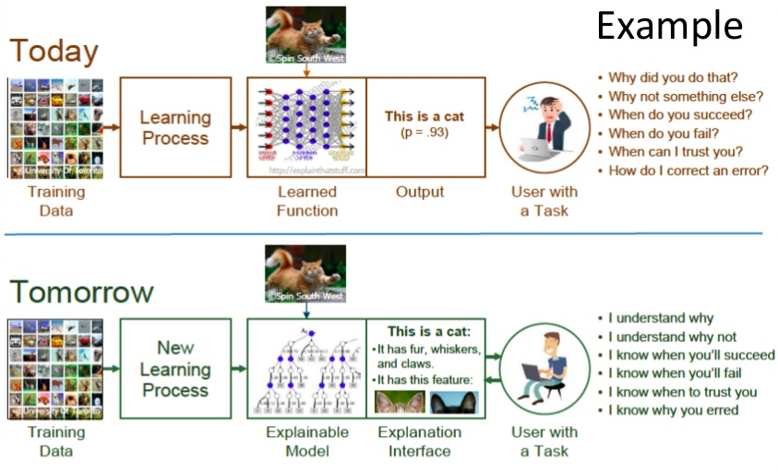
https://www.slideshare.net/ManojkumarParmar/explainable-ai-xai

Slide 4
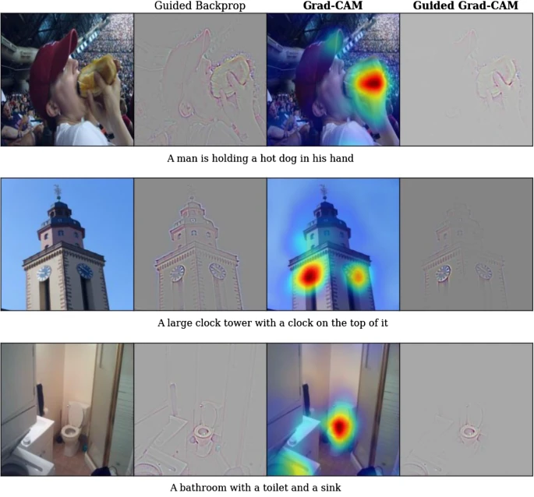
https://arxiv.org/pdf/1610.02391.pdf

Slide 5
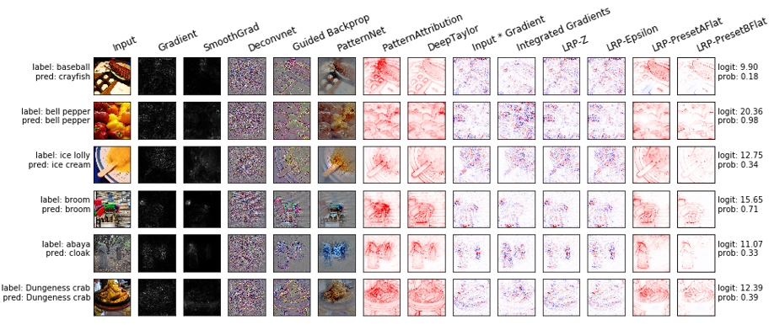
https://github.com/albermax/innvestigate

Slide 6
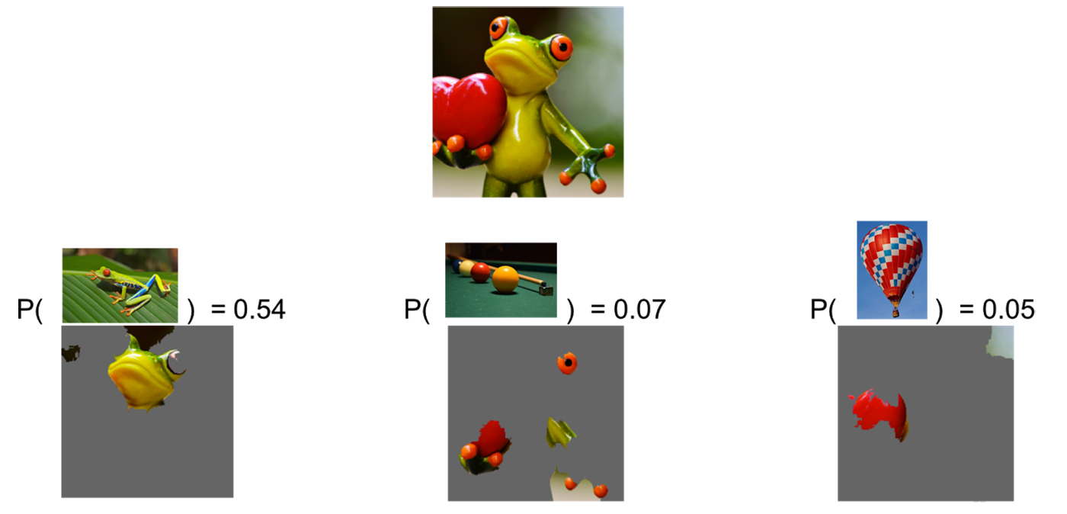
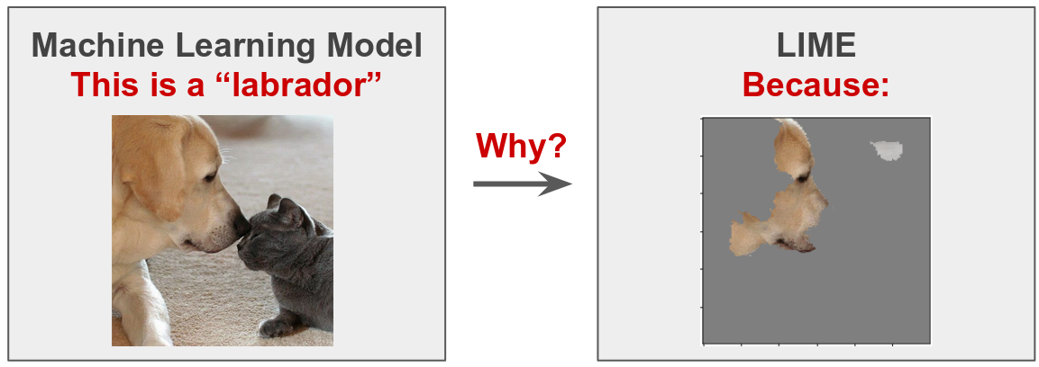
Local Interpretable Model-Agnostic Explanations (LIME)
www.oreilly.com/content/introduction-to-local-interpretable-model-agnostic-explanations-lime
https://towardsdatascience.com/interpretable-machine-learning-for-image-classification-with-lime-ea947e82ca13

Slide 7
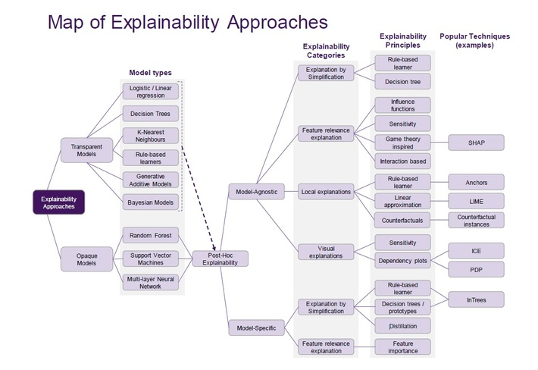
https://www.datasciencecentral.com/profiles/blogs/a-taxonomy-of-explainable-xai-ai-models

Slide 8
Przykłady metod XAI dla zdjęć płuc chorych na Covid-19
Weronika Hryniewska

Slide 9
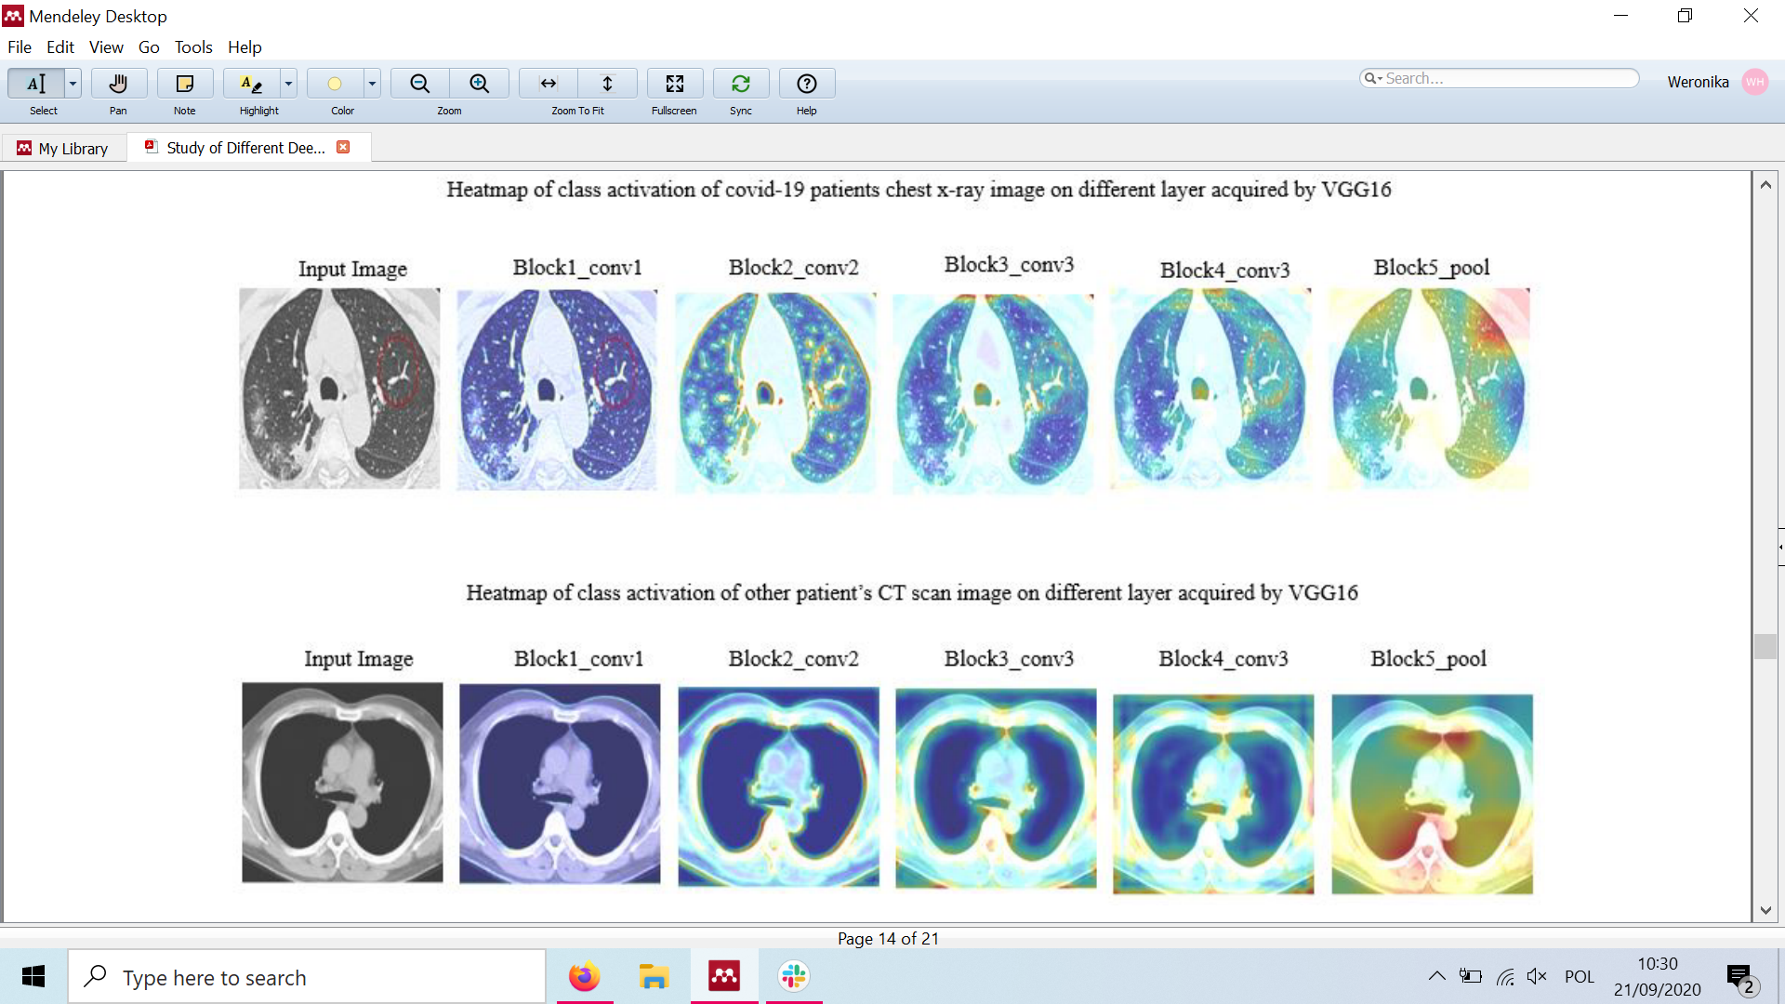
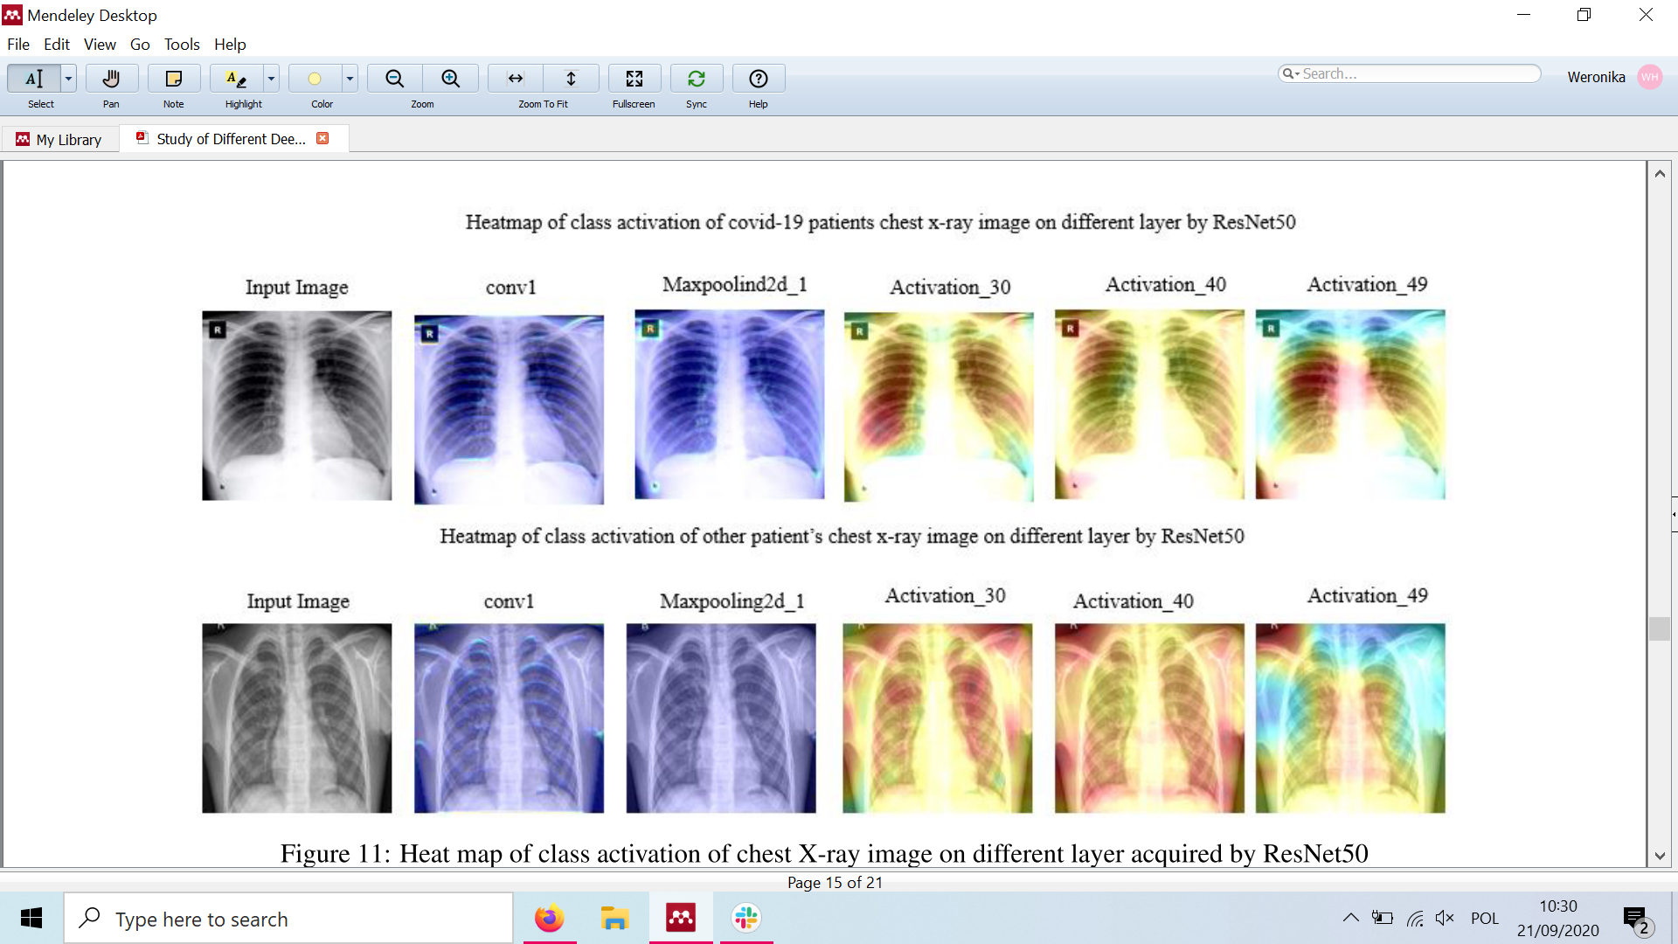
Abbas, A., Abdelsamea, M. M., & Gaber, M. M. (2020). Classification of COVID-19 in chest X-ray images using DeTraC deep convolutional neural network. http://arxiv.org/abs/2003.13815

Slide 10
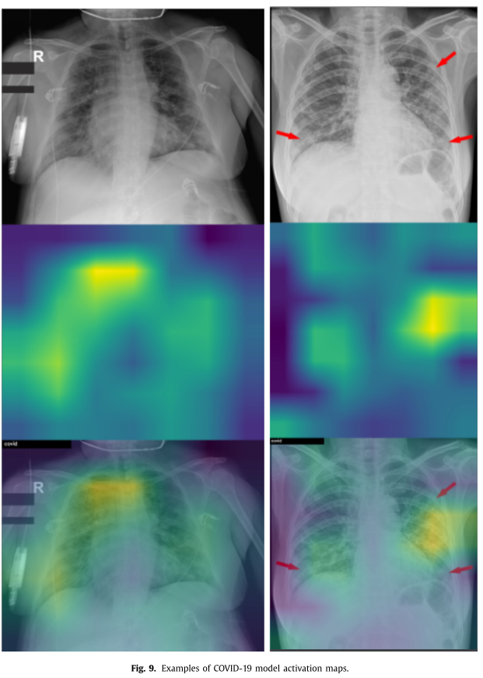
Brunese, L., Mercaldo, F., Reginelli, A., & Santone, A. (2020). Explainable Deep Learning for Pulmonary Disease and Coronavirus COVID-19 Detection from X-rays. Computer Methods and Programs in Biomedicine, 196, 105608. https://doi.org/10.1016/j.cmpb.2020.105608
Are such distances from the marked areas acceptable?
With red arrow the radiologists marked the areas where the COVID-19 disease is manifested, as is shown from the activation maps, the proposed models rightly highlighted the areas marked by the radiologist.
Notes:
Grad-CAM
10

Slide 11
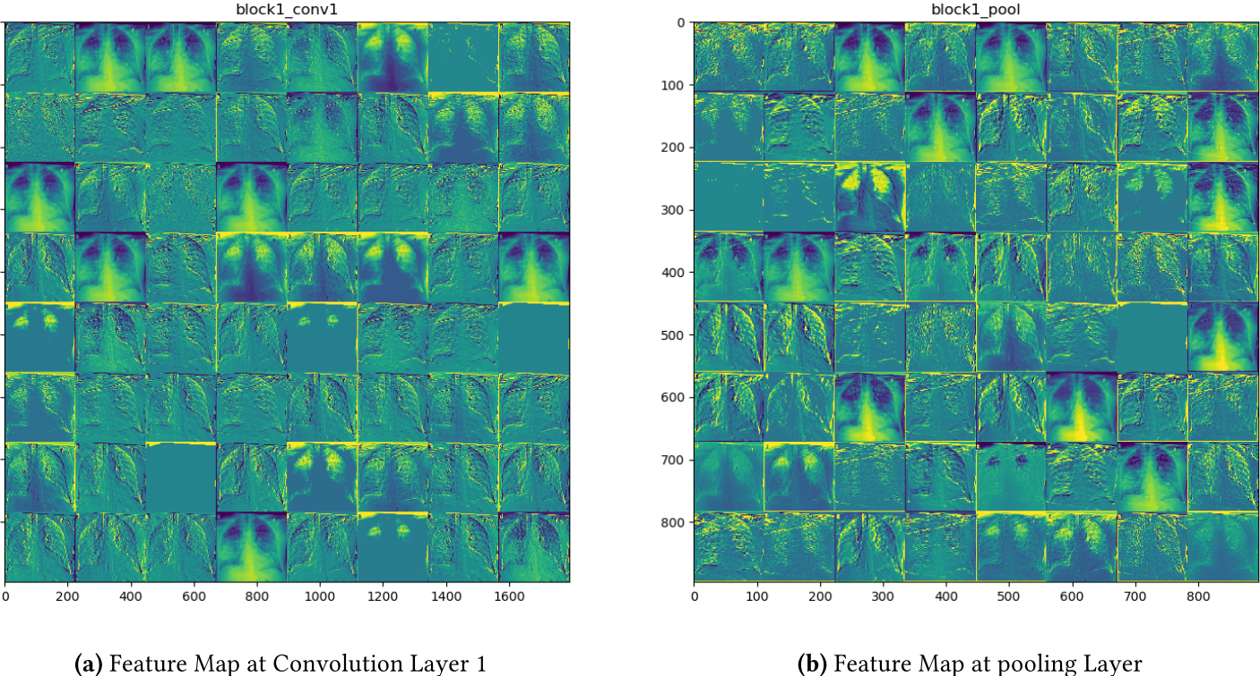
Sharma, V., & Dyreson, C. (2020). COVID-19 detection using Residual Attention Network an Artificial Intelligence approach. http://arxiv.org/abs/2006.16106
Notes:
11

Slide 12
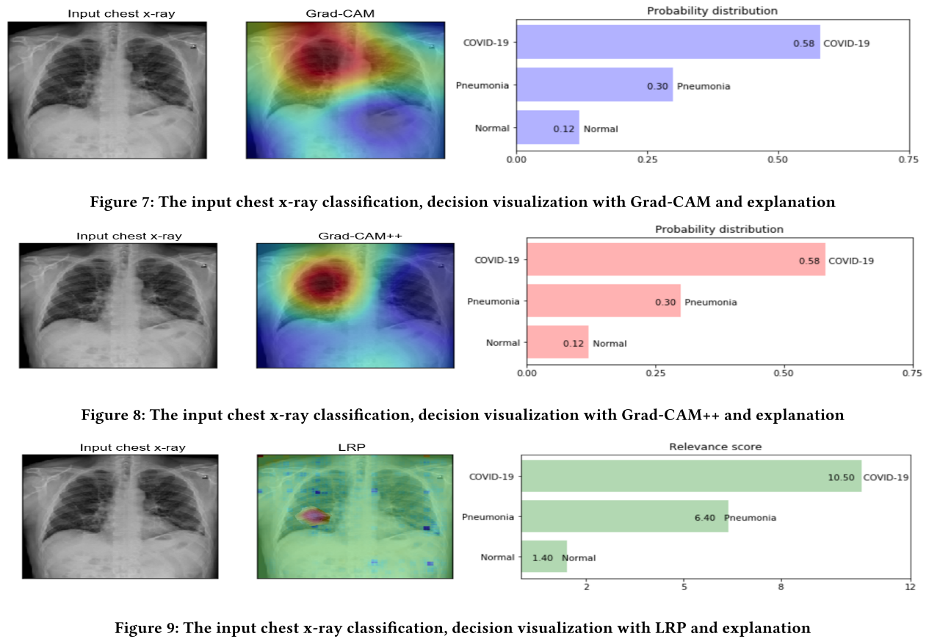
Karim, M. R., Döhmen, T., Rebholz-Schuhmann, D., Decker, S., Cochez, M., & Beyan, O. (2020). DeepCOVIDExplainer: Explainable COVID-19 Diagnosis Based on Chest X-ray Images. http://arxiv.org/abs/2004.04582
Are such big areas relevant?

Slide 13
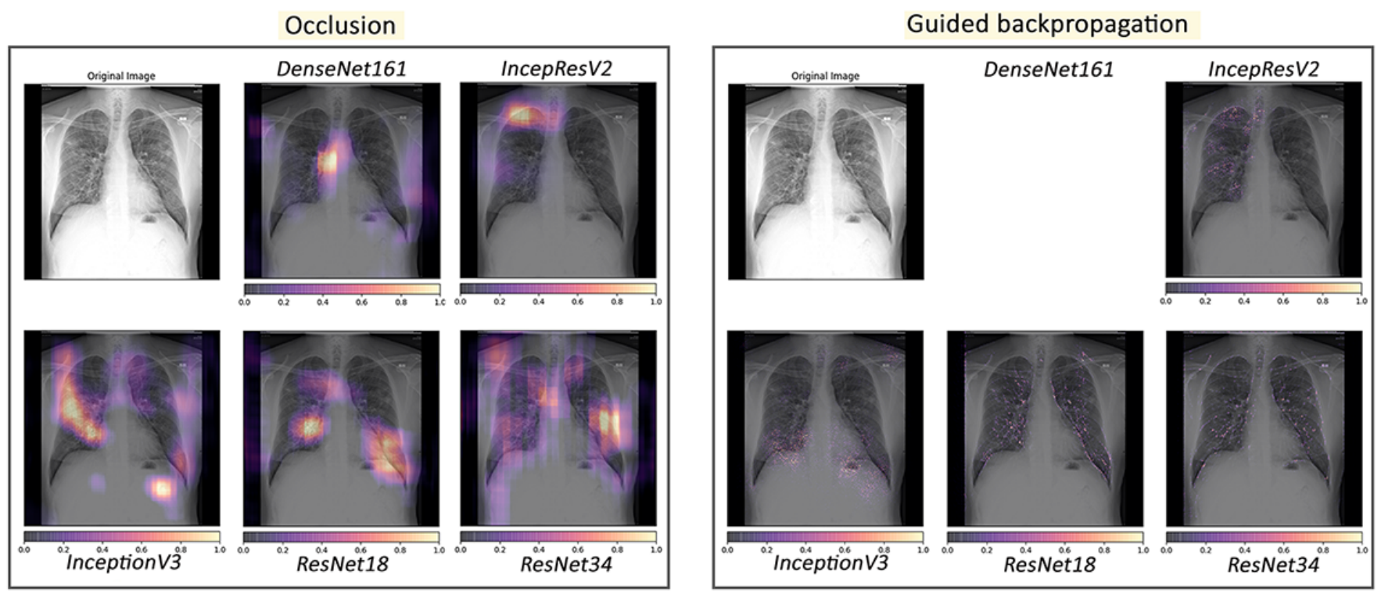
Chatterjee, S., Saad, F., Sarasaen, C., Ghosh, S., Khatun, R., Radeva, P., Rose, G., Stober, S., Speck, O., & Nürnberger, A. (2020). Exploration of Interpretability Techniques for Deep COVID-19 Classification using Chest X-ray Images. http://arxiv.org/abs/2006.02570
Which visualization method is most useful?

Slide 14
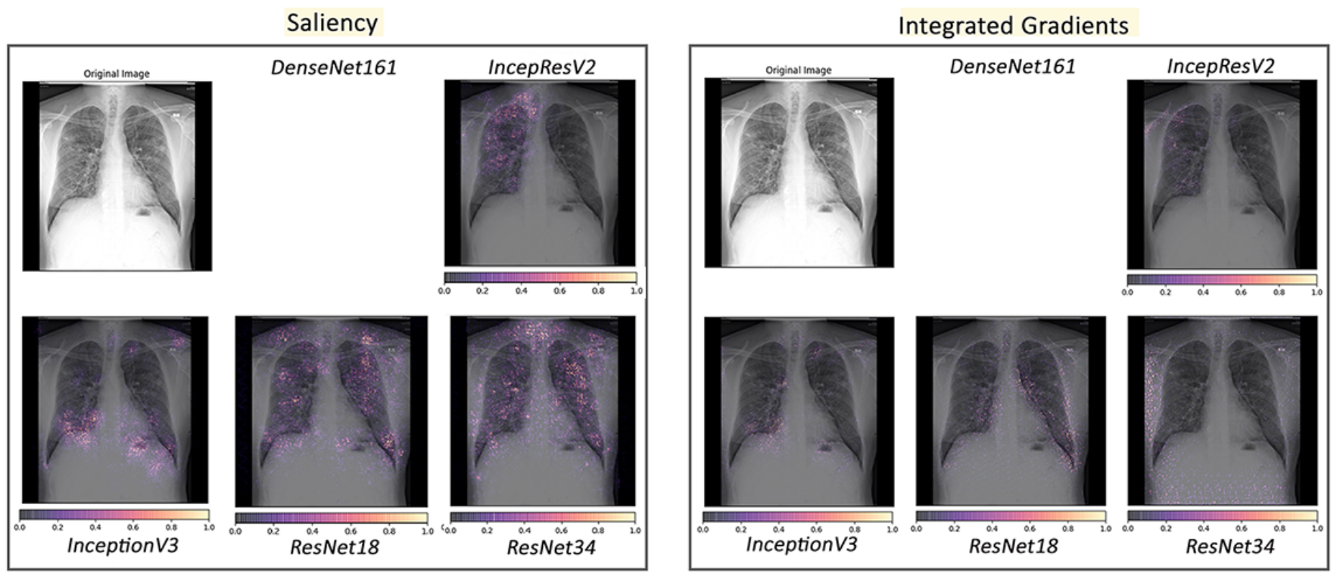

Slide 15
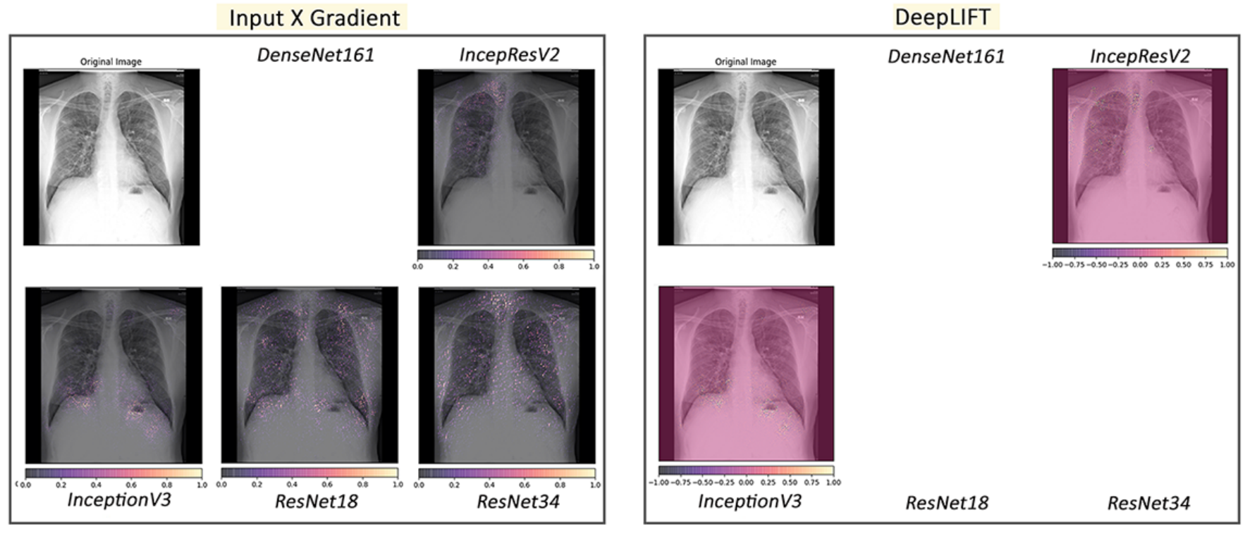

Slide 16
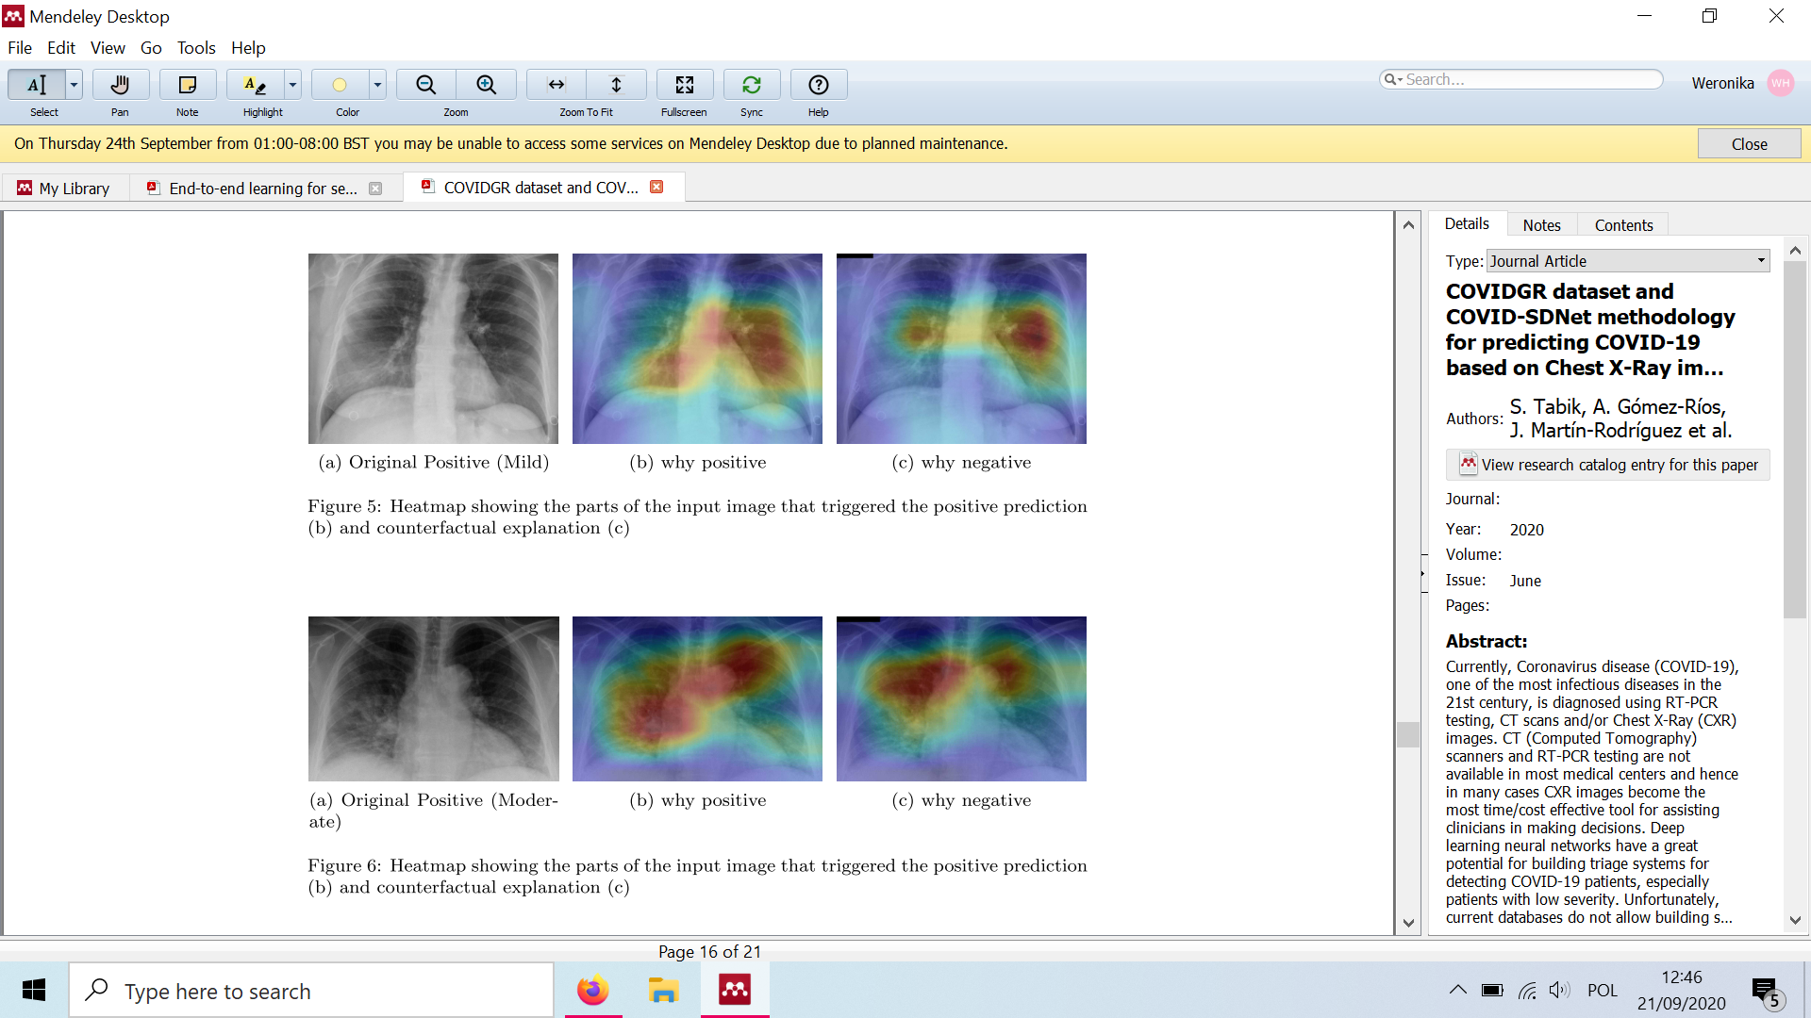
Signoroni, A., Savardi, M., Benini, S., Adami, N., Leonardi, R., Gibellini, P., Vaccher, F., Ravanelli, M., Borghesi, A., Maroldi, R., & Farina, D. (2020). End-to-end learning for semiquantitative rating of COVID-19 severity on Chest X-rays. 1–22. http://arxiv.org/abs/2006.04603
Is the area of changes related to the severity of the disease?

Slide 18
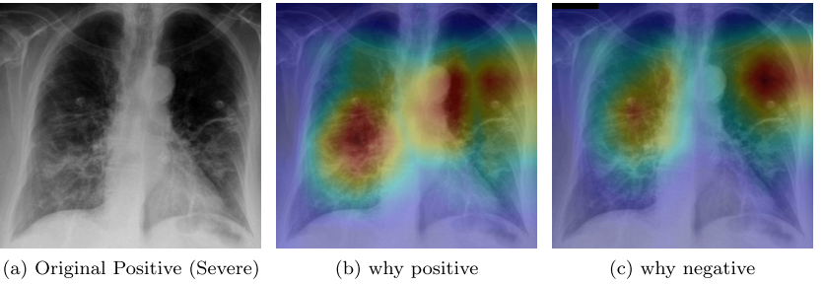

Slide 19
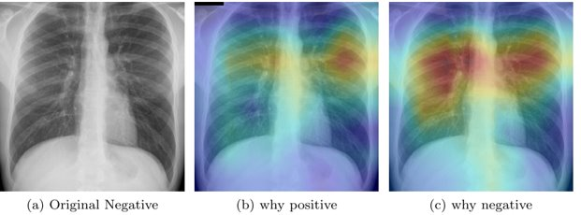

Slide 20
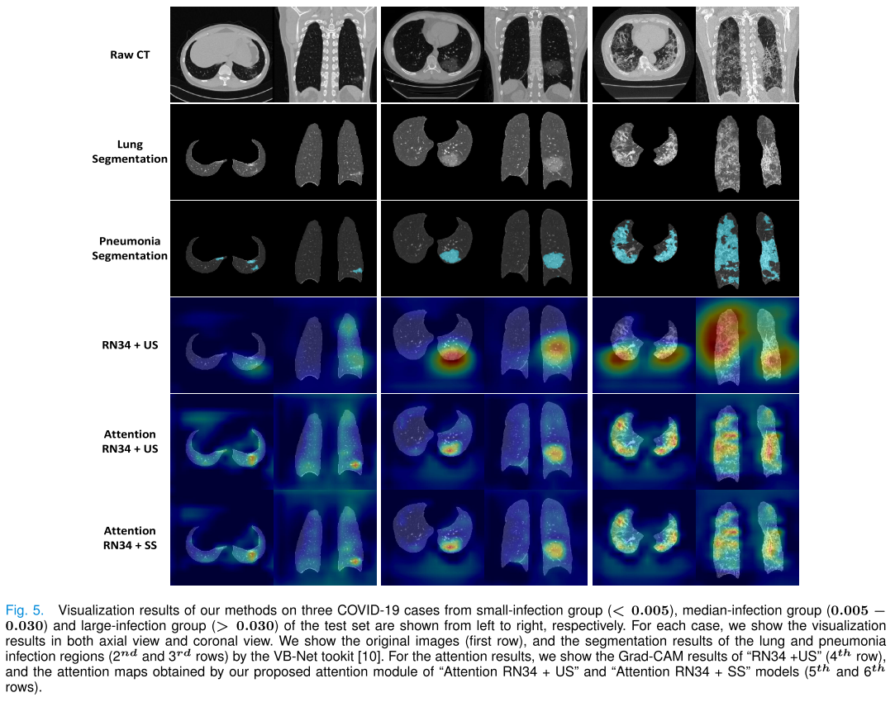
Ouyang, X., Huo, J., Xia, L., Shan, F., Liu, J., Mo, Z., Yan, F., Ding, Z., Yang, Q., Song, B., Shi, F., Yuan, H., Wei, Y., Cao, X., Gao, Y., Wu, D., Wang, Q., & Shen, D. (2020). Dual-Sampling Attention Network for Diagnosis of COVID-19 from Community Acquired Pneumonia. IEEE Transactions on Medical Imaging, 39(XX), 1–1. https://doi.org/10.1109/tmi.2020.2995508

Slide 21
Cohen, J. P., Dao, L., Morrison, P., Roth, K., Bengio, Y., Shen, B., Abbasi, A., Hoshmand-Kochi, M., Ghassemi, M., Li, H., & Duong, T. Q. (2020). Predicting COVID-19 Pneumonia Severity on Chest X-ray with Deep Learning. 8(December 2019). http://arxiv.org/abs/2005.11856
The extent of lung involvement by ground glass opacity or consolidation for each lung (right lung and left lung separately) was scored as:
0 = no involvement;
1 = <25% involvement;
2 = 25-50% involvement;
3 = 50- 75% involvement;
4 = >75% involvement.
The total extent score ranged from 0 to 8 (right lung and left lung together).
The degree of opacity for each lung (right lung and left lung separately) was scored as:
0 = no opacity;
1 = ground glass opacity;
2 = consolidation;
3 = white-out.
The total opacity score ranged from 0 to 6 (right lung and left lung together).

Slide 22
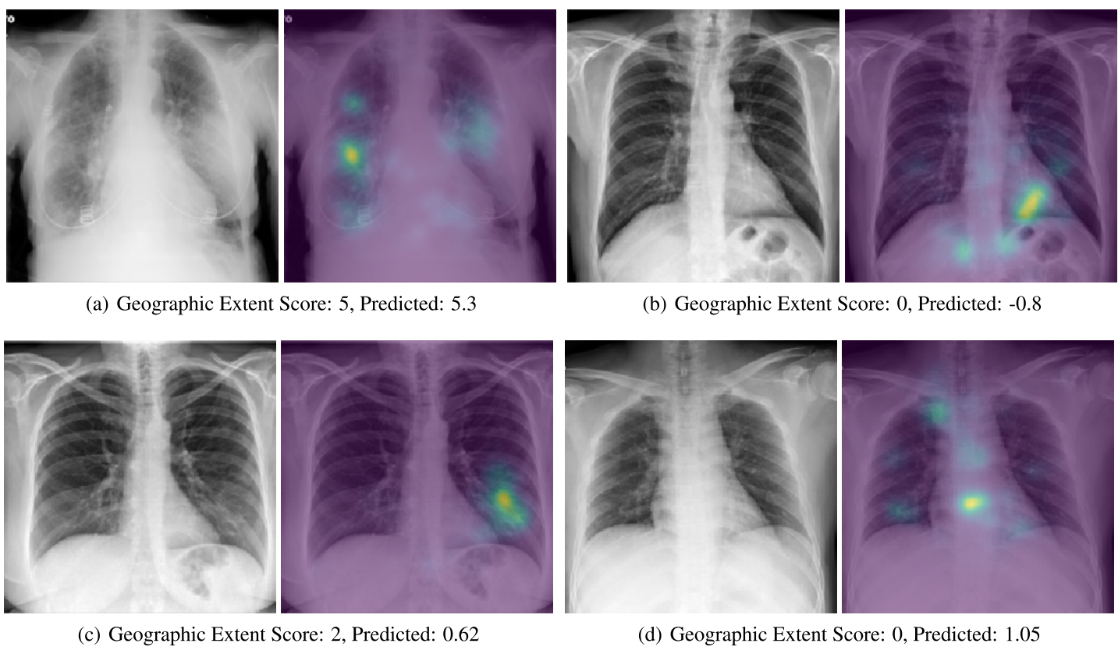

Slide 23
Signoroni, A., Savardi, M., Benini, S., Adami, N., Leonardi, R., Gibellini, P., Vaccher, F., Ravanelli, M., Borghesi, A., Maroldi, R., & Farina, D. (2020). End-to-end learning for semiquantitative rating of COVID-19 severity on Chest X-rays. 1–22. http://arxiv.org/abs/2006.04603
According to it, lungs in anteroposterior (AP) or posteroanterior (PA) views, are subdivided into six zones, three for each lung:
Upper zones (A and D): above the inferior wall of the aortic arch;
Middle zones (B and E): below the inferior wall of the aortic arch and above the inferior wall of the right inferior pulmonary vein (i.e., the hilar structures);
Lower zones (C and F): below the inferior wall of the right inferior pulmonary vein (i.e., the lung bases).
For each zone, a score (ranging from 0 to 3) is assigned, based on the detected lung abnormalities:
0: no lung abnormalities
1: interstitial infiltrates
2: interstitial (dominant), and alveolar infiltrates
3: interstitial, and alveolar (dominant) infiltrate

Slide 24
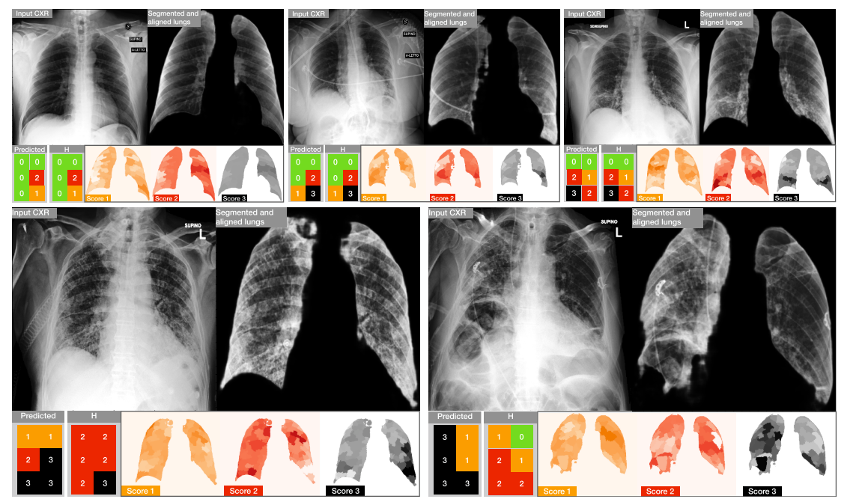

Slide 25
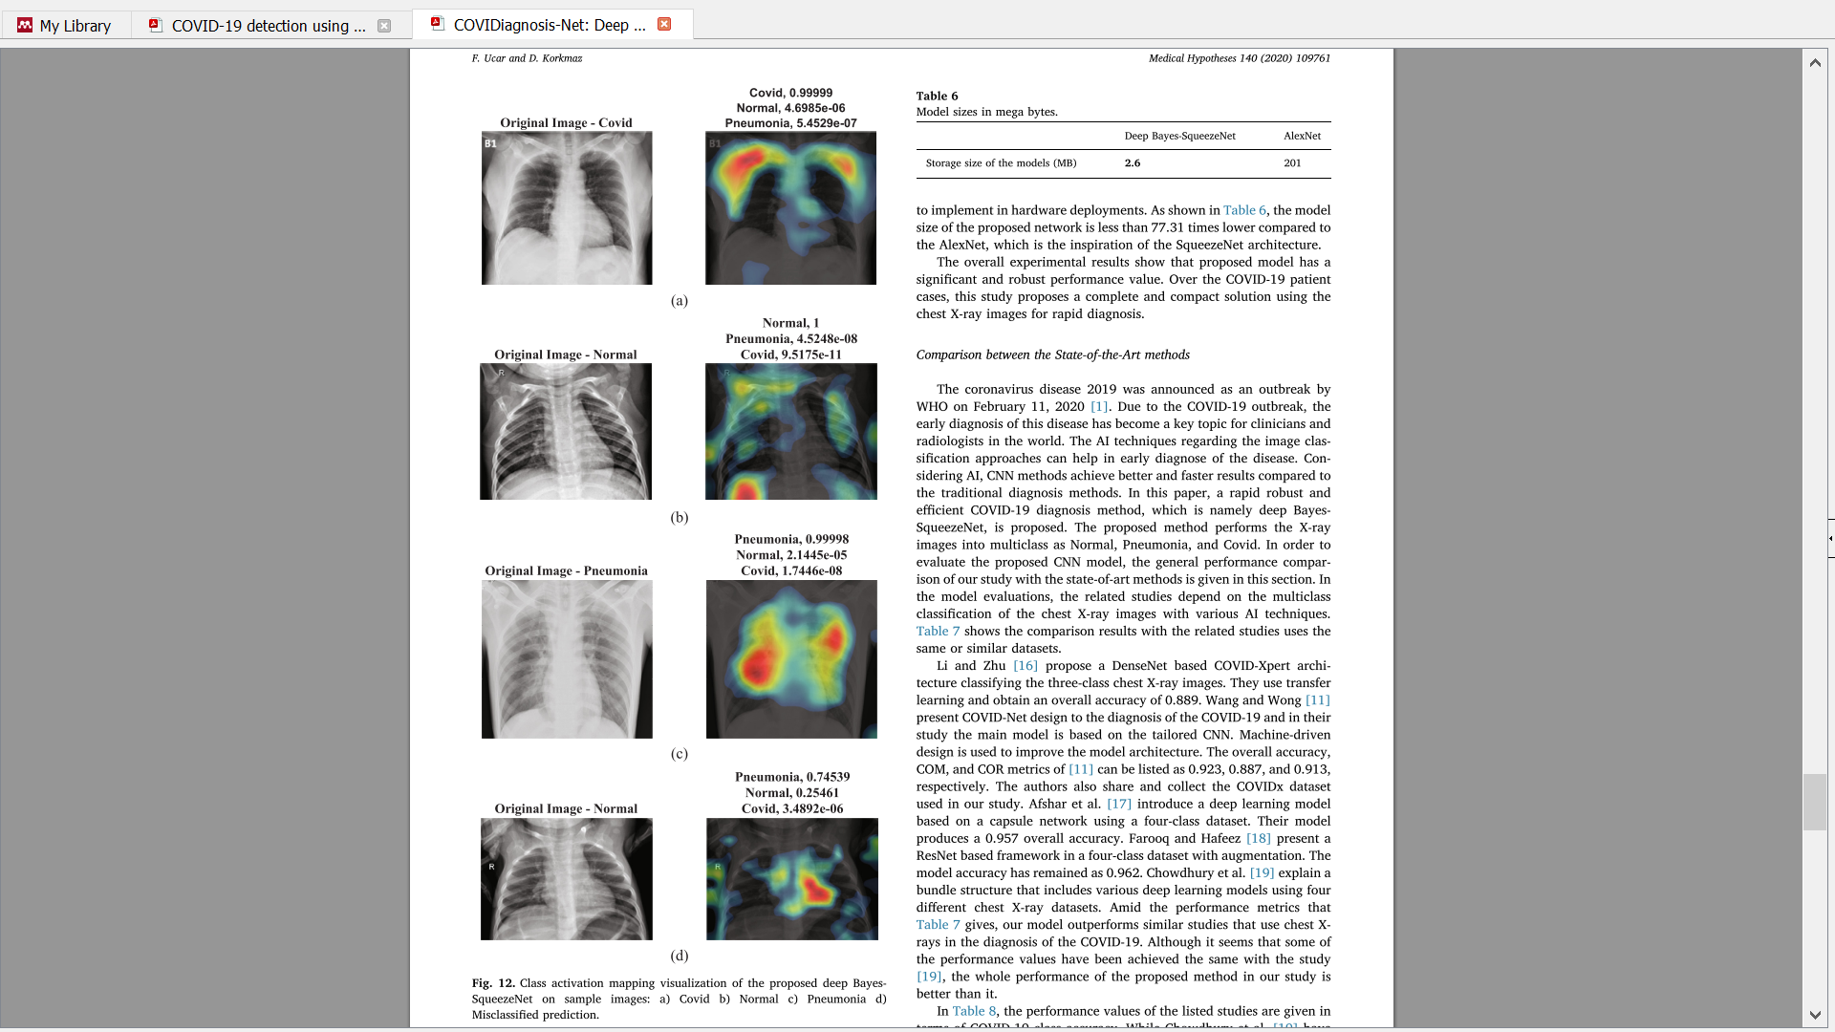
Ucar, F., & Korkmaz, D. (2020). COVIDiagnosis-Net: Deep Bayes-SqueezeNet based diagnosis of the coronavirus disease 2019 (COVID-19) from X-ray images. Medical Hypotheses, 140(April), 109761. https://doi.org/10.1016/j.mehy.2020.109761
Notes:
CAM
25

Slide 26
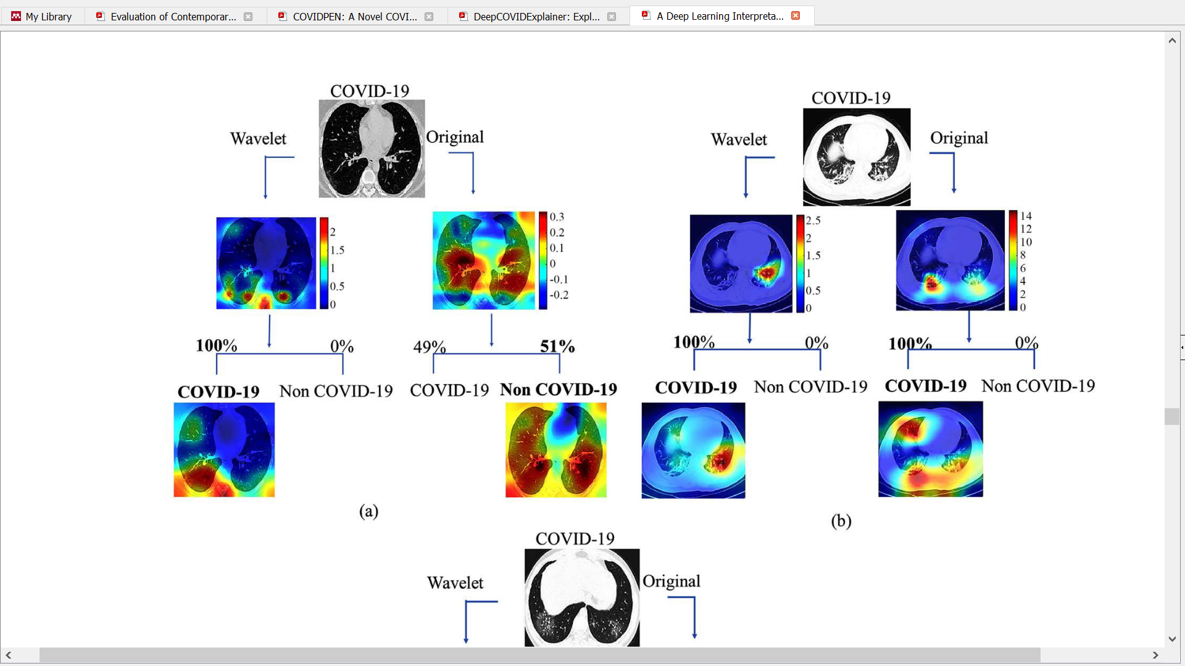

Matsuyama, E. (2020). A Deep Learning Interpretable Model for Novel Coronavirus Disease ( COVID-19 ) Screening with Chest CT Images. Journal of Biomedical Science and Engineering, 13(7), 140–152.
Notes:
Grad-CAM
26

Slide 27
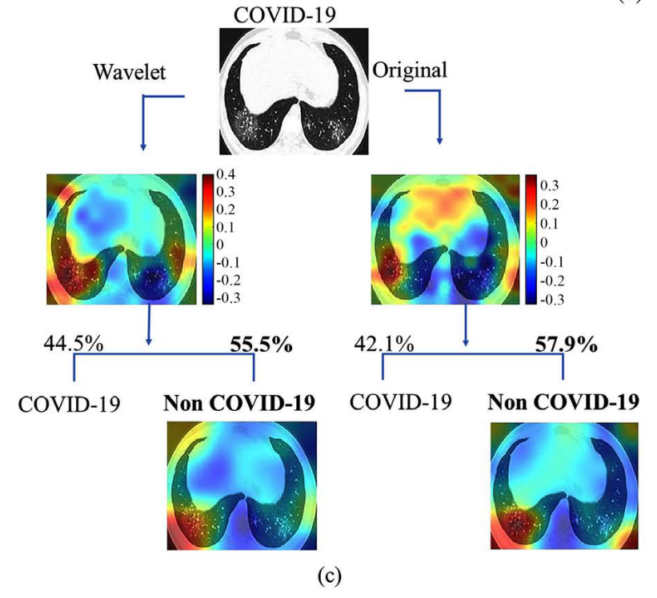

Slide 28
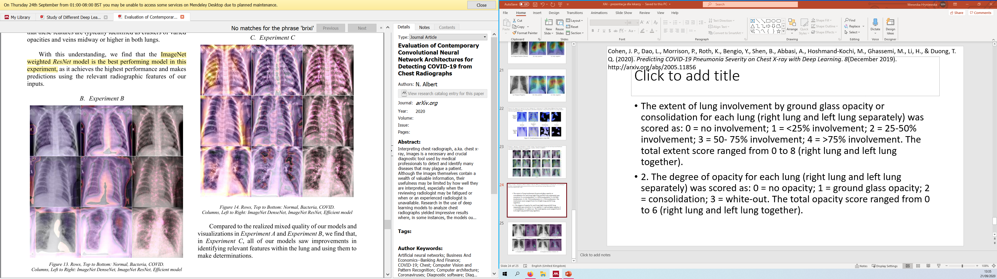
Albert, N. (2020). Evaluation of Contemporary Convolutional Neural Network Architectures for Detecting COVID-19 from Chest Radiographs. ArXiv.Org. https://arxiv.org/abs/2007.01108
Notes:
Grad-CAM
28

Slide 29
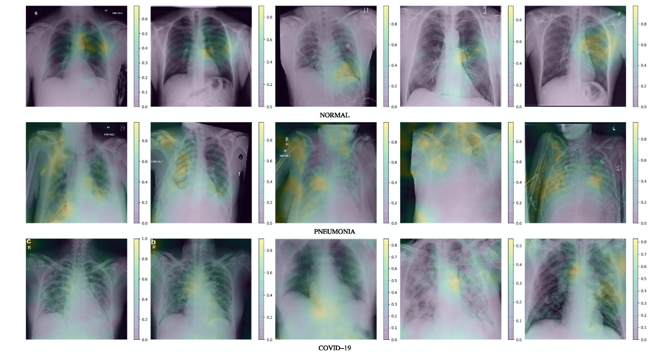
Khobahi, S., Agarwal, C., & Soltanalian, M. (2020). CoroNet: A Deep Network Architecture for Semi-Supervised Task-Based Identification of COVID-19 from Chest X-ray Images. MedRxiv, 2020.04.14.20065722. https://doi.org/10.1101/2020.04.14.20065722
Notes:
attribution maps
29

Slide 30
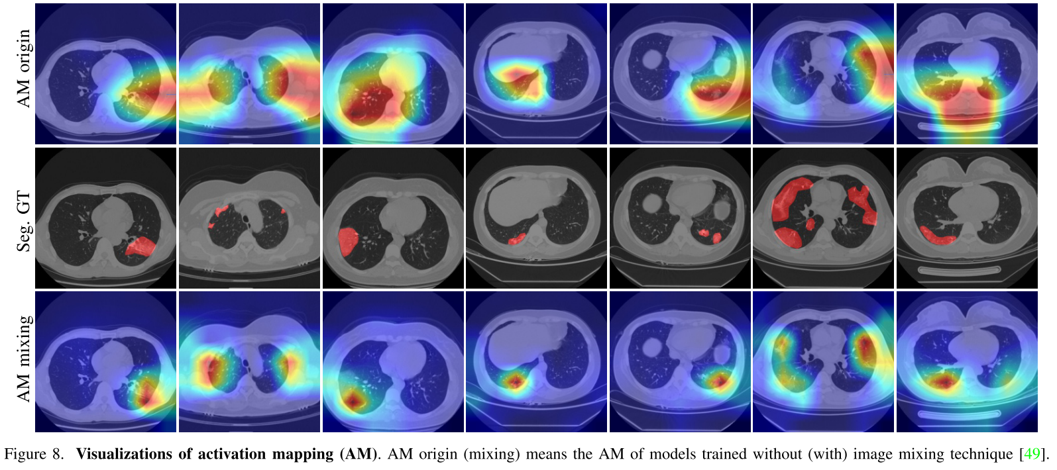
Wu, Y.-H., Gao, S.-H., Mei, J., Xu, J., Fan, D.-P., Zhao, C.-W., & Cheng, M.-M. (2020). JCS: An Explainable COVID-19 Diagnosis System by Joint Classification and Segmentation. 1–11. http://arxiv.org/abs/2004.07054
Notes:
Activation mapping
30

Slide 31
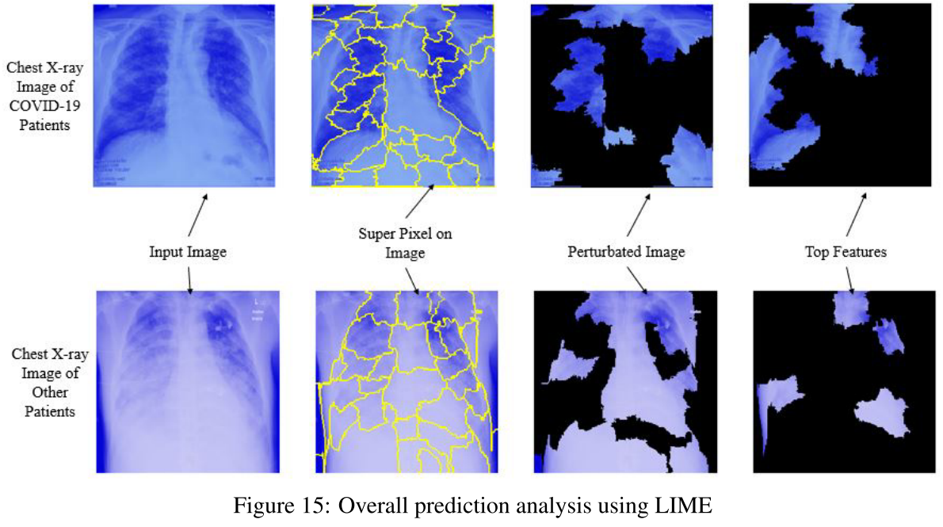
Ahsan, M. M., Gupta, K. D., Islam, M. M., Sen, S., Rahman, M. L., & Hossain, M. S. (2020). Study of Different Deep Learning Approach with Explainable AI for Screening Patients with COVID-19 Symptoms: Using CT Scan and Chest X-ray Image Dataset. http://arxiv.org/abs/2007.12525

Slide 32
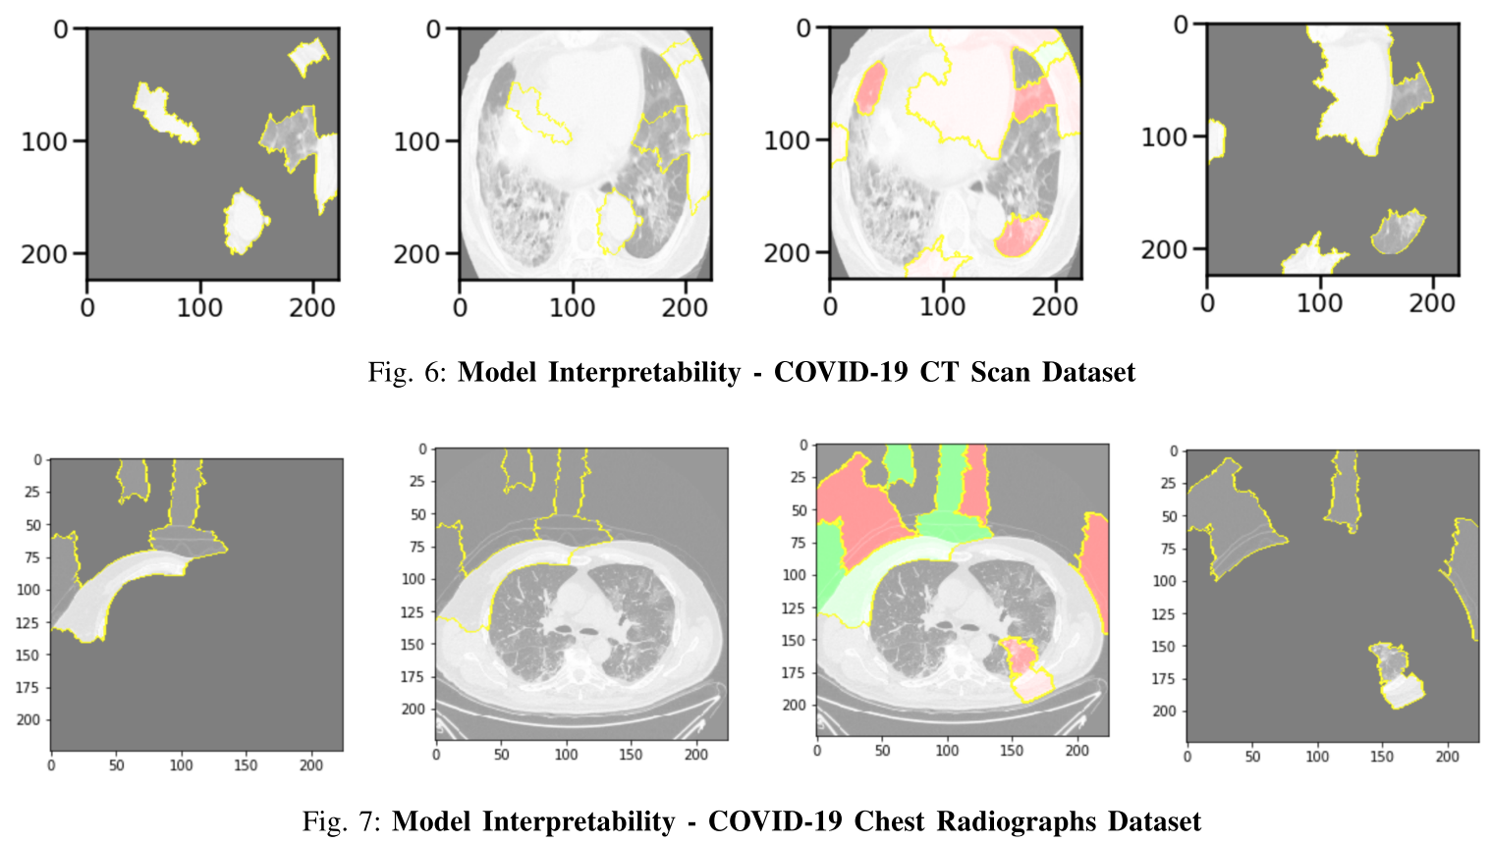
Jaiswal, A. K., Tiwari, P., Rathi, V. K., Qian, J., Pandey, H. M., & Albuquerque, V. H. C. (2020). COVIDPEN: A Novel COVID-19 Detection Model using Chest X-Rays and CT Scans. MedRxiv, 2020.07.08.20149161. https://doi.org/10.1101/2020.07.08.20149161
The regions shaded in pink and green detect superpixels that contributed to and against prediction of chest radiographs and CT scans.

Slide 33
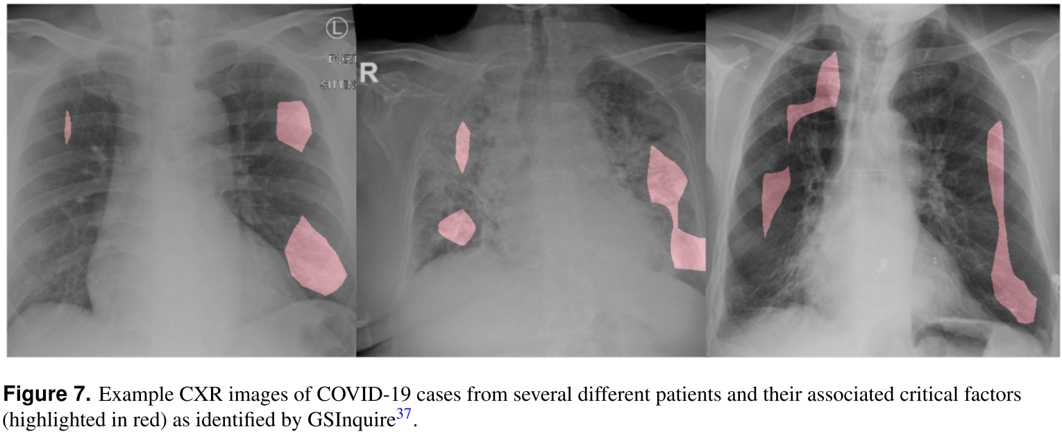
Wang, L., & Wong, A. (2020). COVID-Net: A Tailored Deep Convolutional Neural Network Design for Detection of COVID-19 Cases from Chest X-Ray Images. 1–12. http://arxiv.org/abs/2003.09871

Slide 34
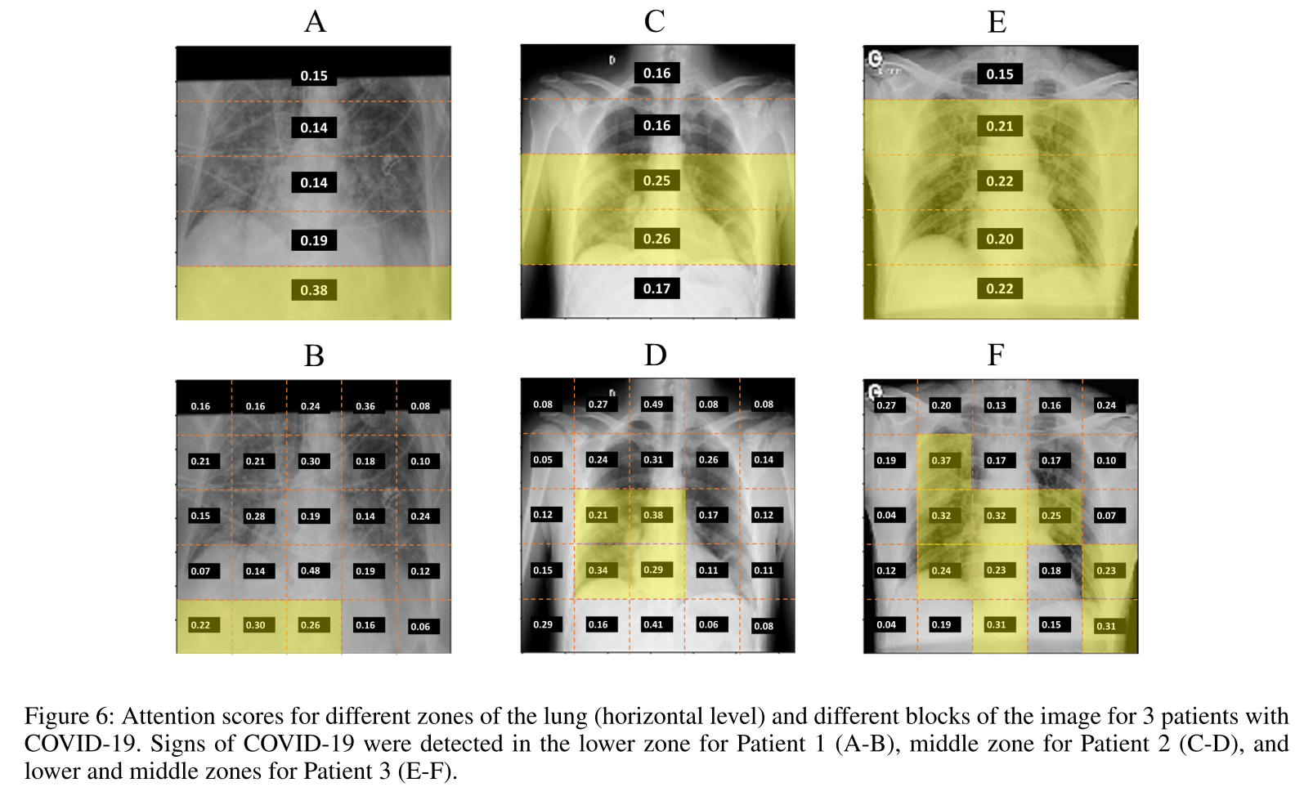
Zokaeinikoo, M., Mitra, P., Kumara, S., & Kazemian, P. (2020). AIDCOV: An Interpretable Artificial Intelligence Model for Detection of COVID-19 from Chest Radiography Images. MedRxiv, 2020.05.24.20111922. https://doi.org/10.1101/2020.05.24.20111922

